Slide 1
Week 10 lec 1
Function overriding

Slide 2
Method Overriding in C++
If we inherit a class into the derived class and provide a definition for one of the base class's function again inside the derived class, then that function is said to be overridden, and this mechanism is called Function Overriding

Slide 3
Requirements for Overriding a Function
Inheritance should be there. Function overriding cannot be done within a class. For this we require a derived class and a base class.
Function that is redefined must have exactly the same declaration in both base and derived class, that means same name, same return type and same parameter list.

Slide 4
Early binding
class A {
public:
void display() {
cout<<"Base class"; } };
class B:public A {
public:
int display() {
cout<<"Derived Class";
} };
int main() {
B obj;
obj.display();
return 0; }

Slide 5
Early binding
In the above example, we are calling the overridden function using derived class object. Compiler gives preference to object type.
Base class object will call base version of the function and derived class's object will call the derived version of the function. This is called early binding
In early binding return type and storage classes are ignored

Slide 6
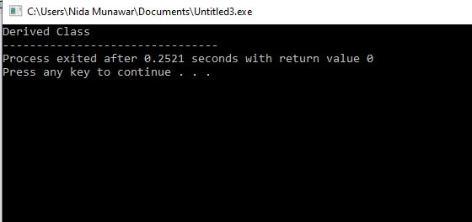
Early binding

Slide 7
Function Call Binding with class Objects
Connecting the function call to the function body is called Binding. When it is done before the program is run, its called Early Binding or Static Binding or Compile-time Binding.

Slide 8
Return type and storage class is not same
class Base {
public:
void print() {
cout << "base class print()" << endl; }};
class Derived : public Base {
public:
int print() {
cout << "derived class print()" << endl;
return 1;}
};
int main() {
Derived derived1;
derived1.print();}

Slide 9
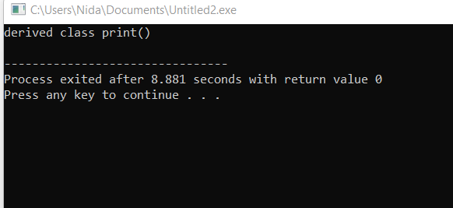
In early binding return type and storage classes are ignored

Slide 10
Can we overload methods in sub class?
Can we overload methods in sub class?
Yes overloading can be done in different scopes but….

Slide 11
Can we overload methods in sub class?
C++ handles overloading across subclasses in a much different way. A member function
declaration in a derived class does not overload member functions with the same name
declared in the base class.
Rather, a member function in a derived class hides the declaration of the member functions
with the same name in base class, even though the function parameter lists are different. Hence, to have member functions from a base class overload member functions from the
derived class, the designer of the derived class can introduce the base class member
functions into the scope of the derived class with using declarations.

Slide 12
Can we overload methods in sub class?
class Check{
int i;
public:
Check(): i(0) { }
void Display()
{ cout << "i of base "<< i <<endl; }};
class Go : public Check{
int i;
public:
Go(): i(1) { }
void Display(int i)
{ cout << "i of child "<< i <<endl; }};

Slide 13
Can we overload methods in sub class?
int main(){
Go g;
g.Display(3); // derived class will hide the Display() func of base class
return 0;}

Slide 14
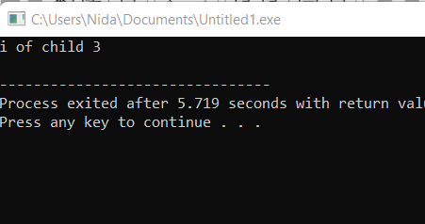

Slide 15
int main(){
Go g;
g.Display();
return 0;}

Slide 16
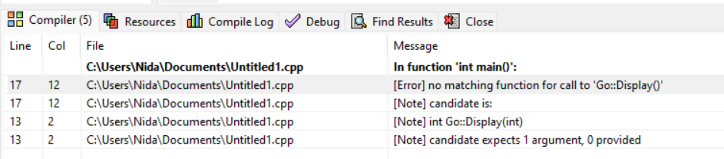
Can we overload methods in sub class?

Slide 17
overloading methods in sub class
#include <iostream>
using namespace std;
class Base{
public:
void foo(int i) {
cout << "Inside foo(int i) i= " << i << "\n"; }};
class Derived : public Base{
public:
// using Base::foo; must be added
// in absence of this simply foo(float f) is called
// in its presence foo(int i) is called, no ambguity
Base::foo;
void foo(float f) {
cout << "Inside foo(float f) f= " << f << "\n"; }};

Slide 18
overloading methods in sub class
int main(){
float f = 1.2f;
int i = 100;
Derived obj;
obj.foo(i); //no compiler error base foo
obj.foo(f); //no compiler error derived foo
}

Slide 19
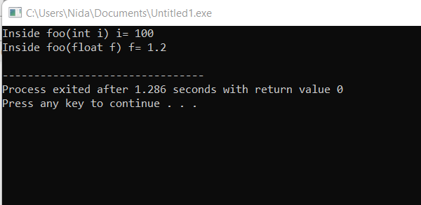
overloading methods in sub class

Slide 20
overloading methods in sub class
The code using Base::foo; makes all the functions named foo (irrespective of their
arguments) from base class directly accessible in the Derived class. Hence the functions
named foo become overloaded in the scope of Derived class. In case of multiple foo
functions in the base class, it is not possible to make only a few "foo" functions from
the base class accessible in the derived class with "Base::foo; " declaration. Since both versions of foo are available in the scope of Derived class, the compiler can
choose specific function from them without any ambiguity here, and the call foo(i) is
correctly resolved to foo(int t).

Slide 21
multiple foo functions in the base class
class Base{
public:
void foo(int i) {
cout << "Inside foo(int i) i= " << i << "\n"; }
void foo() {
cout << "Inside foo(default) " << "\n"; }};
class Derived : public Base{
public:
Base::foo;
void foo(float f) {
cout << "Inside foo(float f) f= " << f << "\n"; }};

Slide 22
multiple foo functions in the base class
int main(){
float f = 1.2f;
int i = 100;
Derived obj;
obj.foo(i);
obj.foo(); //no compiler error
}

Slide 23
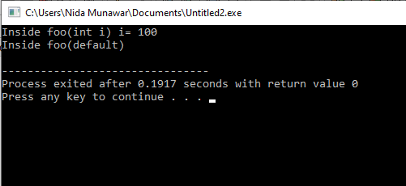
multiple foo functions in the base class

Slide 24
Function Overloading VS Function Overriding
Inheritance: Overriding of functions occurs when one class is inherited from another class. Overloading can occur without inheritance.
Function Signature: Overloaded functions must differ in function signature ie either number of parameters or type of parameters should differ. In overriding, function signatures must be same.
Scope of functions: Overridden functions are in different scopes; whereas overloaded functions are in same scope.
Behavior of functions: Overriding is needed when derived class function has to do some added or different job than the base class function. Overloading is used to have same name functions which behave differently depending upon parameters passed to them.

Slide 25
Week 10 Lecture 2 and 3
Runtime Polymorphism

Slide 26
Compile-time(early binding)
class Base {
public:
void print() {
cout << "base class print()" << endl; }};
class Derived : public Base {
public:
void print() {
cout << "derived class print()" << endl;}};
int main() {
Derived derived1;
Base* base1 = &derived1; //up casting
base1->print();}

Slide 27
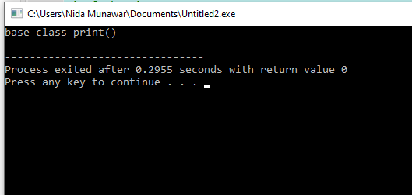
Compile-time(early binding)

Slide 28
Problem
we aimed a base-class pointer at a derived-class object, then invoked member function print through that pointer. but the type of the handle(pointer) determines which class’s functionality to invoke. In that case, the Base class pointer invoked the member function print on the derived-class object, even though the pointer was aimed at a derived-class object that has its own customized print function.
Solution
With virtual functions, the type of the object being pointed to, not the type of the handle, determines which version of a virtual function to invoke.

Slide 29
virtual function
A virtual function is a member function that you expect to be redefined in derived classes. When you refer to a derived class object using a pointer or a reference to the base class, you can call a virtual function for that object and execute the derived class's version of the function.
Virtual functions ensure that the correct function is called for an object, regardless of the expression used to make the function call.

Slide 30
virtual function
They are mainly used to achieve Runtime polymorphism
Functions are declared with a virtual keyword in base class.
The resolving of function call is done at Run-time.

Slide 31
virtual function
class Base {
public:
virtual void print() {
cout << "base class print()" << endl; }};
class Derived : public Base {
public:
void print() {
cout << "derived class print()" << endl;}};
int main() {
Derived derived1;
Base* base1 = &derived1;
base1->print();}

Slide 32
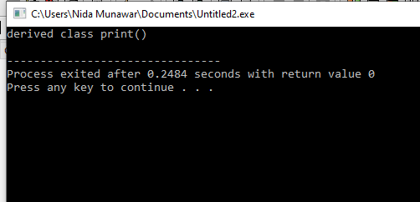
virtual function

Slide 33
Runtime polymorphism is achieved only through a pointer (or reference) of base class type
Late binding(Runtime) is done in accordance with the content of pointer (i.e. location pointed to by pointer) and Early binding(Compile time) is done according to the type of pointer

Slide 34
When calling a function using pointers or references, the following rules apply:
Functions in derived classes override virtual functions in base classes only if their type is the same. A function in a derived class cannot differ from a virtual function in a base class in its return type only; the argument list must differ as well.
A call to a virtual function is resolved according to the underlying type of object for which it is called.
A call to a nonvirtual function is resolved according to the type of the pointer or reference.
The virtual keyword can be used when declaring overriding functions in a derived class, but it is unnecessary; overrides of virtual functions are always virtual.

Slide 35
Rule 4
class Base {
public:
virtual void print() {
cout << "base class print()" << endl; }};
class Derived : public Base {
public:
virtual void print() { // virtual keyword with derived version can be used
cout << "derived class print()" << endl;}};
int main() {
Derived derived1;
Base* base1 = &derived1;
base1->print();}

Slide 36
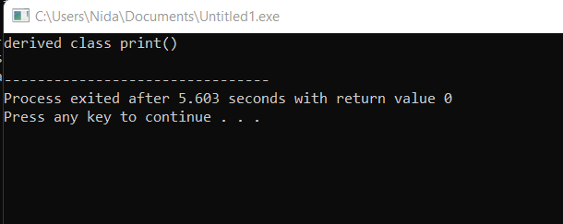

Slide 37
Working of virtual functions(concept of VTABLE and VPTR)
If a class contains a virtual function, then compiler itself does two things:
vtable: A table of function pointers, maintained per class.
It is a table that contains the memory addresses of all virtual functions(only VFs) of a class in the order in which they are declared in a class. This table is used to resolve function calls in dynamic/late binding manner. Every class that has virtual function will get its own Vtable.

Slide 38
Working of virtual functions(concept of VTABLE and VPTR)
2. vptr: A pointer to vtable, maintained per object instance.
After creating Vtable address of that table gets stored inside a pointer i.e. VPTR (Virtual Pointer). When you create an object of a class which contains virtual function then a hidden pointer gets created automatically in that object by the compiler. That pointer points to a virtual table of that particular class.

Slide 39
Compiler adds additional code at two places to maintain and use vptr. 1) Code in every constructor. This code sets the vptr of the object being created. This code sets vptr to point to the vtable of the class. 2) Code with polymorphic function call (e.g. base1->print()in above code). Wherever a polymorphic call is made, the compiler inserts code to first look for vptr using base class pointer or reference (In the above example, since pointed or referred object is of derived type, vptr of derived class is accessed). Once vptr is fetched, vtable of derived class can be accessed. Using vtable, address of derived class function print() is accessed and called.

Slide 40
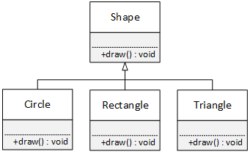
Example (concept of VTABLE and VPTR)

Slide 41
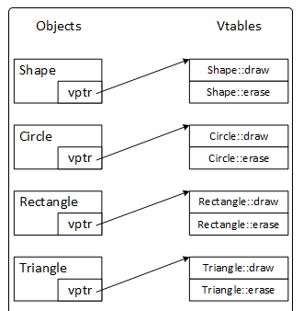
Example (concept of VTABLE and VPTR)

Slide 42
Example (concept of VTABLE and VPTR)
Every polymorphic class has a table of pointers called the vtable that points to the class's virtual functions.
Every polymorphic object contains a pointer called the vptr that points to its class's vtable.

Slide 43
Example (concept of VTABLE and VPTR)
The vptr and the vtable are only used to locate virtual functions. When all of the prerequisites for polymorphism are in place and a virtual function is called, the correct function is located and dispatched (i.e., called) by a specific sequence of steps. Assume that we have a Circle object named c created, and further assume that the draw function is a virtual function.
Circle c;
Shape * s = &c;
s->draw();

Slide 44
The steps that the compiler follows to call the correct function is as follows:
The address stored in c's vptr is retrieved
The address is followed to the Circle vtable (this address was stored in c's vptr by the Circle constructor)
The Circle vtable is searched for a function named draw
The function to which the draw entry in the vtable points is called

Slide 45
polymorphic does have some overhead:
It requires enough space in every polymorphic object to store a pointer (four to eight bytes)
It requires enough space to store the address of every virtual function in a program (i.e., there is a pointer entry in every vtable of every class in an inheritance hierarchy for each virtual function)
There are two pointer dereference operations for every polymorphic function call: one to find the vtable and one to find the function
There is time required to search the vtable for the correct virtual function

Slide 46
Task
Class A{
Virtual void foo1();
Virtual void foo2();
Virtual void foo3();
void foo();};
Class B : public A{
void foo1();
void foo2(2);
void foo();}

Slide 47
Derived-Class Member-Function Calls via Base-Class Pointers
Off a base-class pointer, the compiler allows us to invoke only base-class member functions. (object slicing we will discuss it in RTTI)
Thus, if a base-class pointer is aimed at a derived-class object, and an attempt is
made to access a derived-class-only member function, a compilation error will occur.
The compiler generates errors on these calls, because they’re not made to member functions of base-class

Slide 48
Derived-Class Member-Function Calls via Base-Class Pointers
class Base {
public:
virtual void print() {
cout << "base class print()" << endl; }};
class Derived : public Base {
public:
void print() {
cout << "derived class print()" << endl;}
void show() {
cout << "only derived class member function" << endl;}};
int main() {
Derived derived1;
Base* base1 = &derived1;
base1->print();
base1->show();}

Slide 49
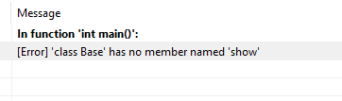
Derived-Class Member-Function Calls via Base-Class Pointers

Slide 50
Can I override static function C++?

Slide 51
Can I override static function C++?
Static methods cannot be overridden because method overriding only occurs in the context of dynamic (i.e. runtime) lookup of methods. Static methods (by their name) are looked up statically (i.e. at compile-time).

Slide 52
Early binding
#include <iostream>
using namespace std;
class base{
public:
static void func(){
cout << "inside base"<< endl; }};
class child:public base{
public:
void func(){
cout << "inside child"<< endl; }};
int main(){
base* b ;
child c;
b = &c;
b -> func();
}

Slide 53
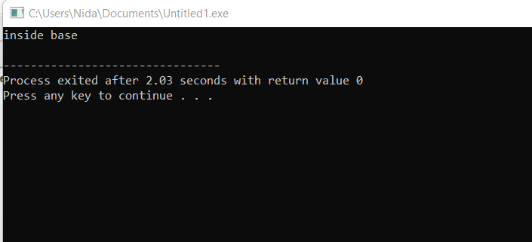
Early binding

Slide 54
Static in run time polymorphism
#include <iostream>
using namespace std;
class base{
public:
virtual static void func(){
cout << "inside base"<< endl; }};
class child:public base{
public:
void func(){
cout << "inside child"<< endl; }};
int main(){
base* b ;
child c;
b = &c;
b -> func();
}

Slide 55


Slide 56
Important point
A derived class virtual function is only considered overridden if its signature and return type must match exactly

Slide 57
A derived class virtual function is only considered overridden if its signature and return type must match exactly
class Base {
public:
virtual void print() {
cout << "base class print()" << endl; }};
class Derived : public Base {
public:
int print() {
cout << "derived class print()" << endl;
return 1;}
};
int main() {
Derived derived1;
Base* base1 = &derived1 ; //up casting
base1->print();
}

Slide 58
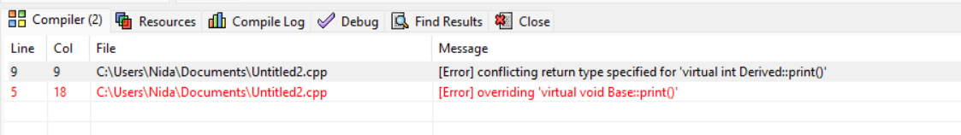

Slide 59
can we override const method with non const in c++

Slide 60
It is neither overloading nor overriding. Rather, it is hiding.
const is part of the signature, and leaving it off changes the signature, and thus hides the method rather than overrides it. "

Slide 61
class Base {
public:
virtual void print() const{
cout << "base class print()" << endl; }};
class Derived : public Base {
public:
void print() {
cout << "derived class print()" << endl;
}
};
int main() {
Derived derived1;
Base* base1 = &derived1 ; //up casting
base1->print();
}

Slide 62
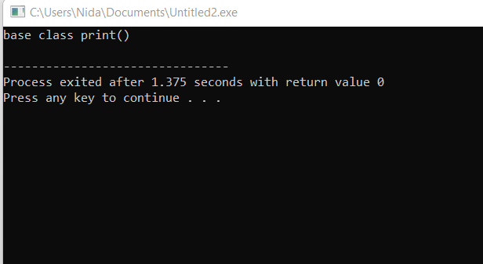

Slide 63
How to prevent class inheritance and method overriding in C++
Use of final specifier in C++ 11:

Slide 64
uses final specifier after the function parameter list to prevent method overriding
class Base {
public:
virtual void print() final{
cout << "base class print()" << endl; }};
class Derived : public Base {
public:
void print() {
cout << "derived class print()" << endl; }};
int main() {
Derived derived1;
Base* base1 = &derived1 ; //up casting
base1->print();}

Slide 65
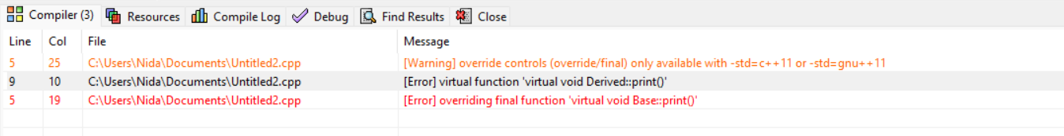

Slide 66
final specifier is used after the class name to prevent inheritance
#include <iostream>
using namespace std;
class Base final {
};
class Derived : public Base {
};
int main() {
Derived derived1;
}

Slide 67
